Slide 1

StockWise

Slide 2



Our team
Eshan Gujarathi
Hitarth Gandhi
Chaitanya Guntoorkar
Chief Executive Officer
Chief Technical Officer
Chief Marketing Officer

Slide 3
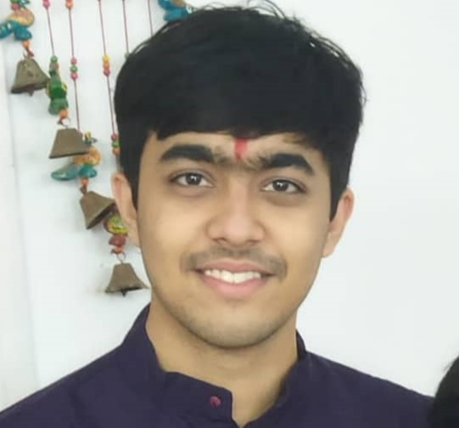
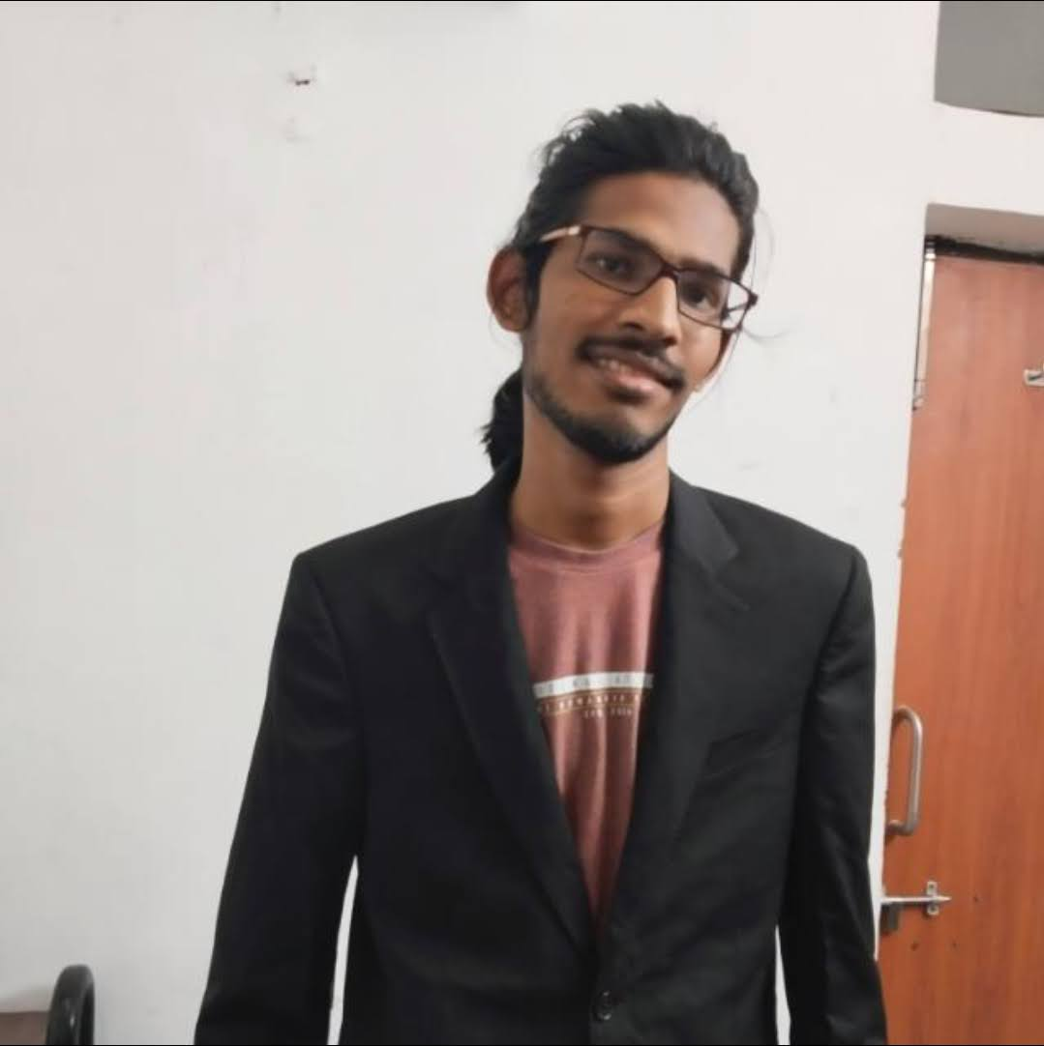

Our team
Shreyash Agrawal
Yash More
Aadesh Desai
Chief Operating Officer
Chief Product Officer
Chief Financial Officer

Slide 4

Our Company
We are a B2B AI-powered SaaS company that provides
Real-time Inventory Management
Sales and Stock level forecasting
Analytical Insights
Insights from Competitors
Notes:
Our state-of-the-art platform allows grocery store operators to easily and accurately track their inventory in real-time, from anywhere. With our intuitive software, clients can stay on top of stock levels, identify trends, and make informed purchasing decisions to optimize their operations and increase profitability.

Slide 5

Initial Hypothesis
Problem
Solution
Shop owners face the problem of deadstock, resulting in financial losses, as well as sustainability concerns caused by excess inventory. Additionally, the unique SKUs carried by each store create varying inventory management challenges.
AI-powered SaaS solution that analyzes product trends and predicts inventory needs, automatically generating orders when shortages are detected.

Slide 6
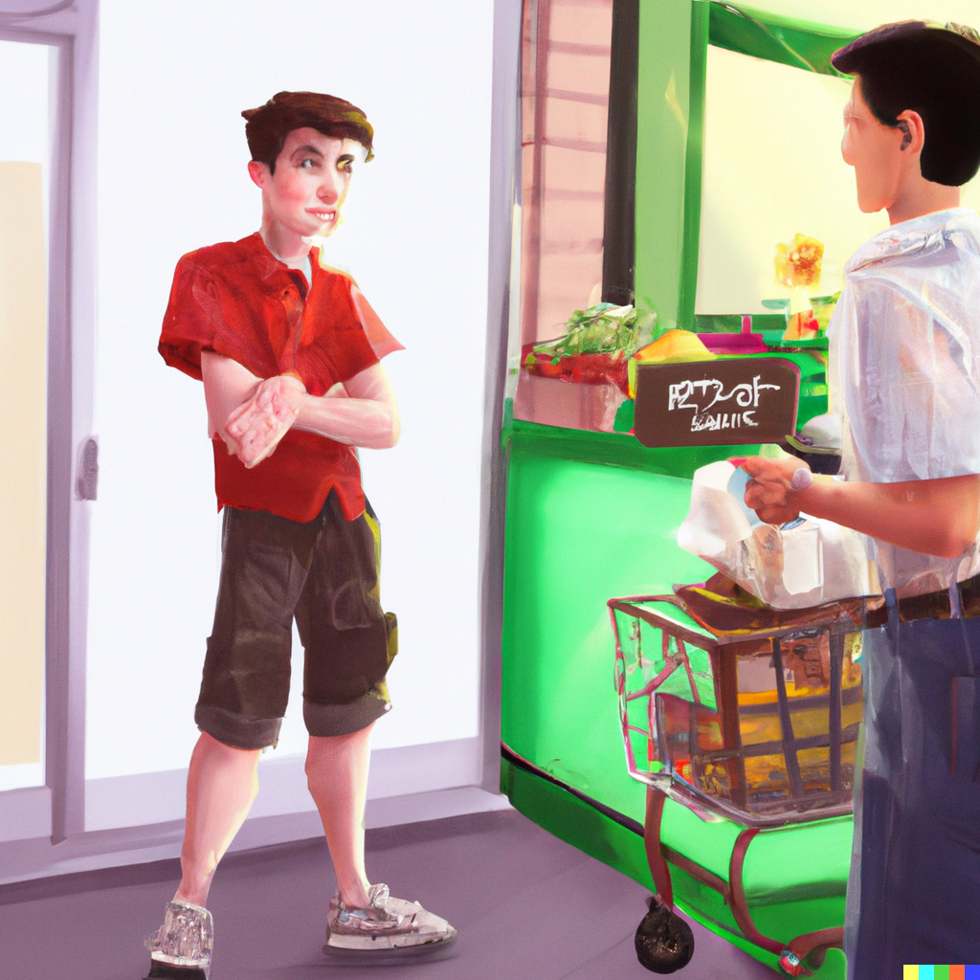
Assumptions
Known continuous and constant demand.
Constant price and visible to everyone
No shortages are permitted.
There is a need of a standardised platform.
Solving the problem keeping grocery as the domain.

Slide 7
Go To Market Guesstimate for Grocery Inventory
Indian Population
~ 140 cr
4 members in a family on an average
35 cr families
Small Scale Customer 10 cr
Mid Scale Customer 20 cr
Large Scale Customer 5 cr
Store:Family 3:1
Store:Family 7:1
Store:Family 10:1
Small Scale Store ~3.5 cr
Small Scale Store ~2.8 cr
Small Scale Store 0.5 cr
Repeat rate 20%
Repeat Rate 30%
Repeat rate 40%
Market Size 0.7 cr stores
Market Size 1.5 cr stores
Market Size 0.2 cr stores
Go To Market
1,50,00,000 * 500 p/m * 12 m * (1+16%)^1 = 1,04,40,00,00,000 = 10k crore Link.
TAM

Slide 8
Target Market Segment
Customer
Expected Revenue
Number of customer (25%) = 0.375 cr
Average Purchase value (APV) = 500 pm
Average Customer Lifetime (ACLT) = 0.5 yr
Average Purchase frequency rate (APFR) = 1
Customer Lifetime Value (CLV) = APV*ACLT*APFR = 3000.
Revenue = 1.5 cr * 3000 = 450 cr
Expected Growth = 16%
Company
Ideal business fundamentals suggest Customer Lifetime Value should be at least three times greater than your Customer Acquisition Cost (CAC).
So according to our calculation we can have a CAC of 1k based on our revenue.
Competitor
Competitors didn’t consider market segmentation. Same pricing model irrespective of business size.
Don’t provide analytical insights and forecasting, only deal with real time management.
Use pre-trained query. You need to change the query to accommodate variations.

Slide 9
Interview Questions
Do you struggle with managing your stock?
How often do you struggle with this issue?
Do you think others in your business face a similar problem?
How do you tackle this problem of inventory management?
How did you come up with this solution?
How happy are you with your solution? What are the challenges faced by you while employing this solution?
How much does your current solution cost? How is this solution affecting your revenue?
Are you actively searching for/trying other solutions?
Potential clients interviewed:
JK Grocery, Atul Bakery, Krupa Generals, Radhe Pharmacy, Vendiman, Amul Store

Slide 10
Compilation of Responses From Potential Customers
Most are using some software that requires a lot of manual operations such as data entry.
This issue of inventory management is also faced by other type of stores like dairy, small daily needs stores, etc.
Shop owners are looking for a solution that is very easy and intuitive to use.
Owners expressed the need for more authority over suggestions from software. E.g., software shouldn’t always automatically place an order of goods.
Predictive Forecasting using AI is more or less absent from current solutions in use by the owners.
Proprietors wished for more automation in inventory management and less manual feeding.
Current softwares require around Rs. 6k-10k one time installation charges and Rs. 800 - 2k pm for extra services.
Business owners seek AI software that can offer robust insights and suggestions based on sales data to minimize deadstock and shortage.

Slide 11
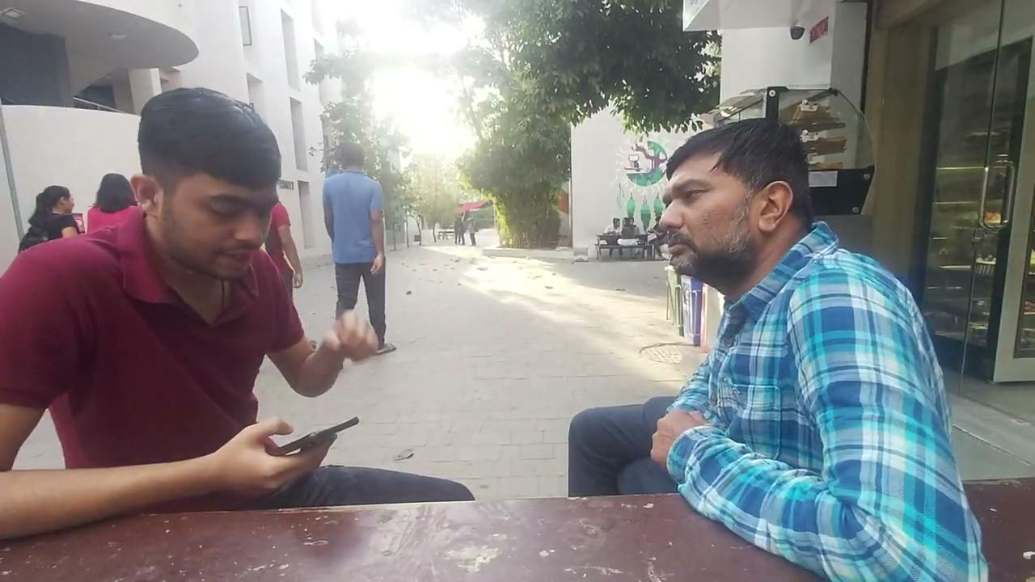
Listen to Our Own JK Grocery Owner
Link
Other Testimonials

Slide 12

Competitor Analysis
RetailEdge: POS equipment and software company
TradeGecko
No major player using AI powered techniques
Not a single player in the Indian market
Products designed for US market won’t work for the Indian market
Notes:
Retail Edge POS
Only one stop solution. $495 for all its services. They are not considering market segmentation in terms of business size as we are inculcating in out model. It manages existing sales and data, live inventory management. Real time order processing and pricing strategy, no forecasting of stocks.
Trade Gecko
Visualised sales, profit results but do not provide understandable insights. They have to understand themselves. Live tracking, no predictive. They use pre trained query. Unless you change the rules, The software won’t learn on the go.

Slide 13
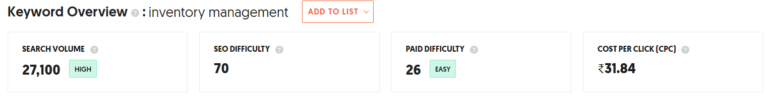
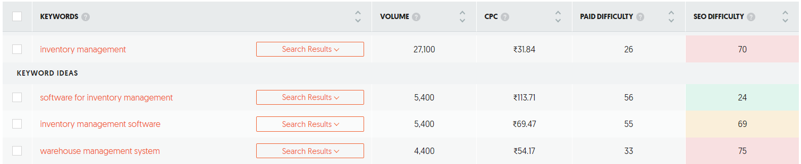
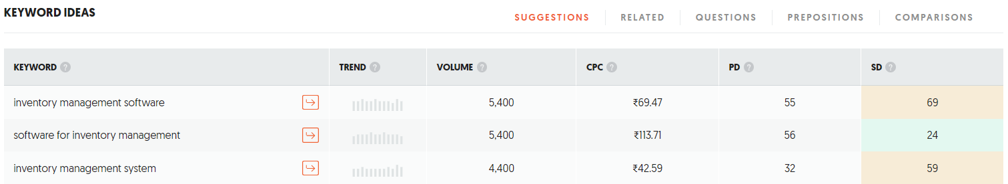
Buzzing or Not?
High SEO score shows that it’s difficult to rank websites based on organic traffic. This open up a window for us to enter the arena via paid route.
Source: UberSuggest
Notes:
High SEO score shows that it’s difficult to rank websites based on organic traffic. This open up a window for us to enter the arena via paid route.

Slide 14
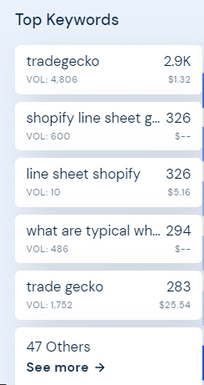
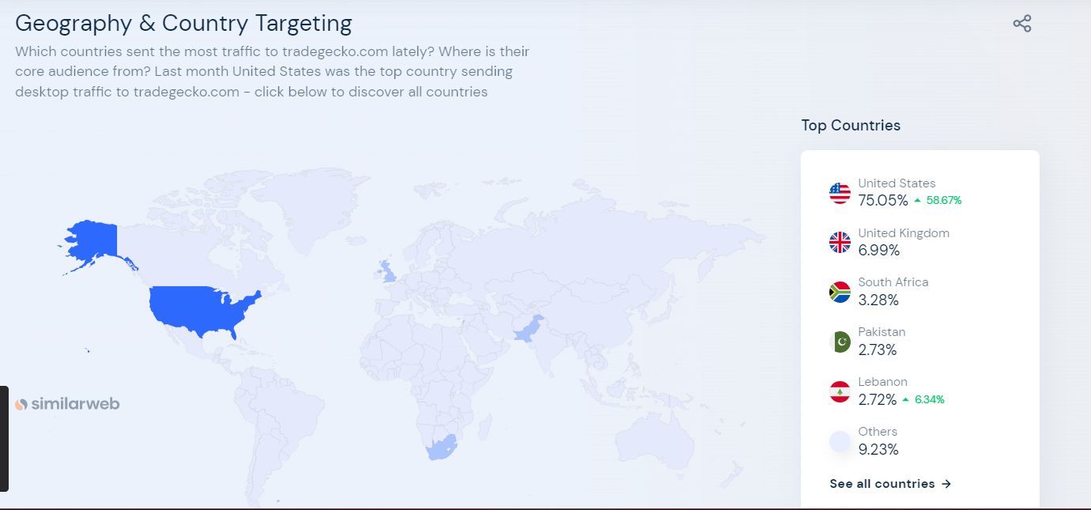
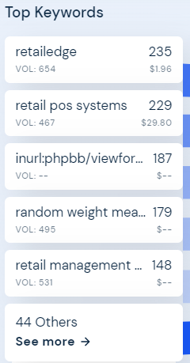
What are the competitor’s
audience searching for?
https://www.similarweb.com/website/tradegecko.com/#interests
Notes:
After analysing the keywords of our top competitors, we get to know that both companies have their name as the top keywrodss.

Slide 15
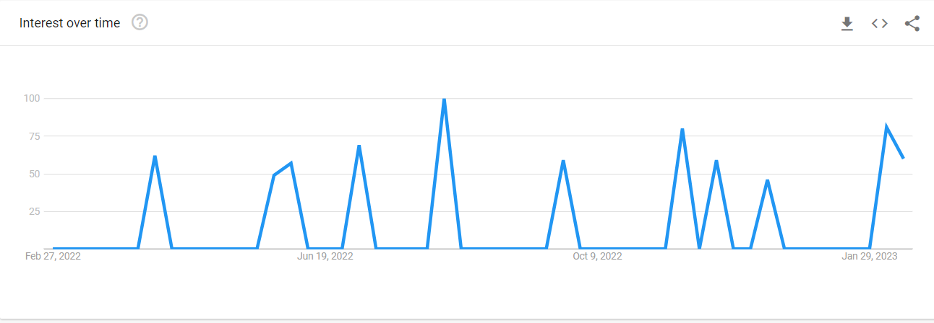
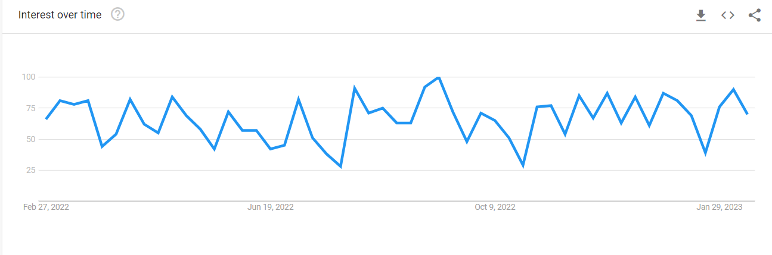
Stock wise
Stockwise

Slide 16
Revised Hypothesis
Problem
Solution
Shop owners face the problem of excessive deadstock and surplus stock causing financial loss and sustainability issues, compounded by the difficulties of automatic ordering which sometimes prevent them from replacing unwanted products.
An AI-powered SaaS solution for different kinds of stores with high automation requiring little manual input from the user that leverages advanced data analytics to analyze product trends and predict inventory needs can provide shop owners with robust suggestions on what products to order, when to order them, and in what quantity.
Notes:
Problem:
Domain expansion

Slide 17
Product Strategy
Target Segment - Medium Scale Businesses (1 Lakh to 1 Cr)
Customer Need - To automate the processes of maximizing profit on a product X without wastage.
Market Trend - The number of products is increasing as companies produce similar products while also incorporating evolving AI technology.
Value Proposition - Increased profitability through reduced workforce remuneration and remote access, while also increasing consumer satisfaction.
Differentiation - Train models using Indian cultural and regional data, leveraging AI adaptiveness, and incorporating differential privacy techniques to learn regional trends while preserving privacy and improving generalizability.
Success Metrics - No. of stores using our product who have increased profitability and reduced deadstock and shortage.
Risks - There is a risk of data leakage and AI learning incorrect trends, potentially leading to inaccurate suggestions, especially when outliers are present in the data

Slide 18

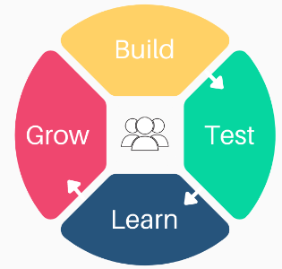

Key Partners
Key Activities
Value Proposition
Customer Relationship
Customer Segment
Platform
Analytics & Insights
Reporting & Forecasting
Deadstock management
Demand forecasting
Product insights
Segmented market based on size
Small-scale
(<1 lakh profit)
Medium-scale
(1 lakh - 1 cr profit)
Large-Scale
(1 cr profit)
Vendors
Supermarkets
Grocery Stores
Dedicated Personal Assistance followed by Self service
Key Resources
Channels
Physical
Intangible
Human Resource
Partner stores
Trade Shows and Events
Referral Marketing
Costs
Revenue Stream
Data-handling servers
AI model training
Licensing
Technical Assistance
Salary
Pricing Model
Small Scale
Medium Scale
Large Scale
Basic (1000 p-m)
Basic (5000 p-m)
Basic (50000 p-m)
Premium
Premium
Premium

Slide 19
Thanks!
Do you have any questions?
You can contact us at!
eshan.rg@iitgn.ac.in
shashikant.gc@iitgn.ac.in
hitarth.g@iitgn.ac.in
desai.aadesh@iitgn.ac.in
shreyash.a@iitgn.ac.in
yash.mh@iitgn.ac.in

